Slide 1
Dencun Upgrade
& Proto-Danksharding
hduoc2003

Slide 2
Contents
Rollup’s problems
Proto-Danksharding
1XXX
2XXX
3XXX
4XXX
Dencun Upgrade
Danksharding

Slide 3
Rollup’s problems

Slide 4
Rollup’s problems
Transaction costs
Storage
Proof
Tx batch is stored by calldata:
Permanent
Not cheap enough

Slide 5
Dencun Upgrade

Slide 6
Dencun Upgrade
Published at 13/03/2024
Dencun is just a ton of EIP, for:
Scalability, fees reduction (EIP-4844)
Security (EIP-6780)
Reducing on-chain data storage fees (EIP-1153)
Enhanced Designs for Bridges and Staking Pools (EIP-4788)
Removing code that terminate SM (EIP-6780)
Backbone is EIP-4844, focus on Rollup

Slide 7
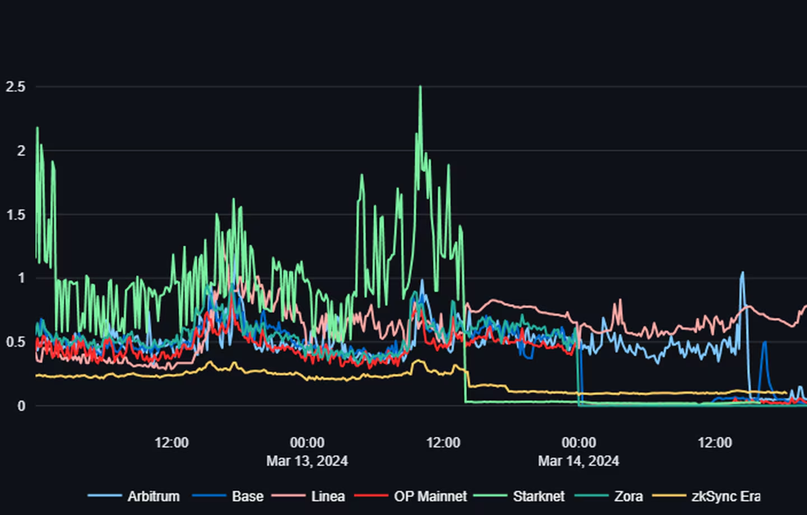
Dencun Upgrade
The median transaction cost in USD for seven layer 2s (growthepie)

Slide 8
Dencun Upgrade
L2 | Tx costs | Reduction
Base | $0.026 | 96%
Optimism | $0.027 | 95%
Arbitrum | $0.051 | 95%
ZkSync | $0.108 | 65%

Slide 9
Proto-Danksharding

Slide 10
Proto-Danksharding
EIP-4844:
Introduce “blob-carrying transactions”, blob gas
Target of 3 blobs, maximum of 6 blobs per block
Blob:
Size 128kB
Stored in beacon node (consensus layer) for 4096 epochs (~18 days)
Committed by KZG commitment

Slide 11
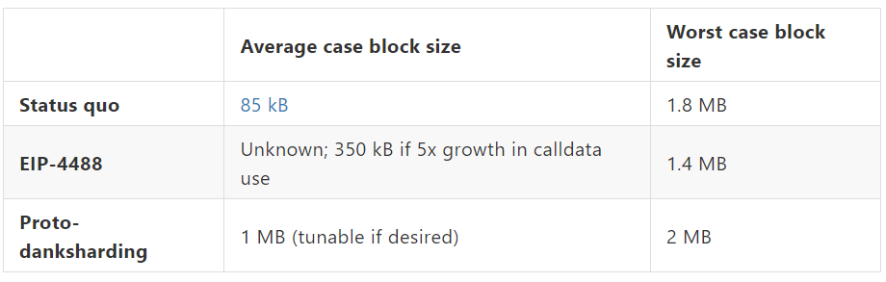
Proto-Danksharding
Block size comparing

Slide 12
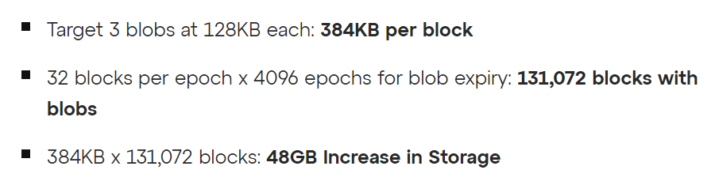
Proto-Danksharding
Storage of Nodes

Slide 13
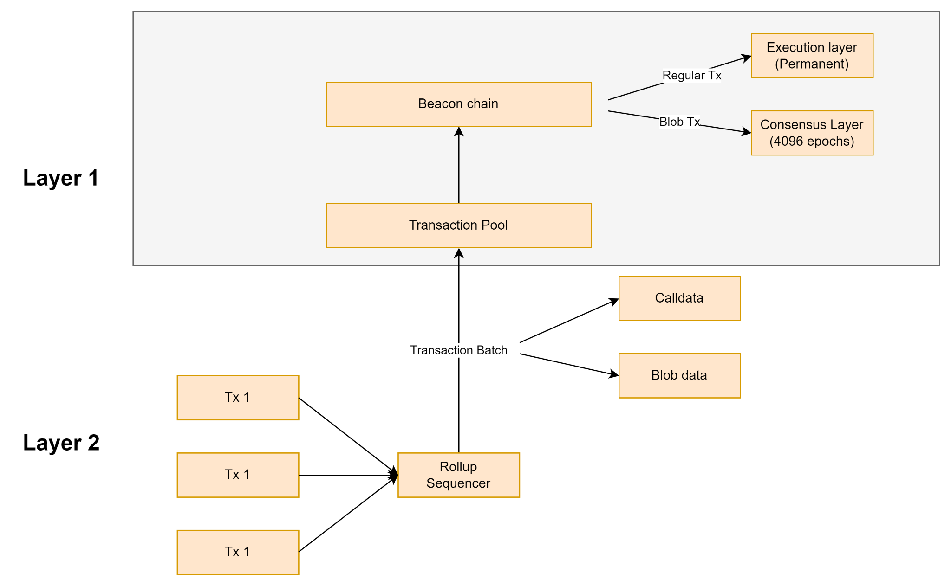
Proto-Danksharding
Basic flow after EIP-4844

Slide 14
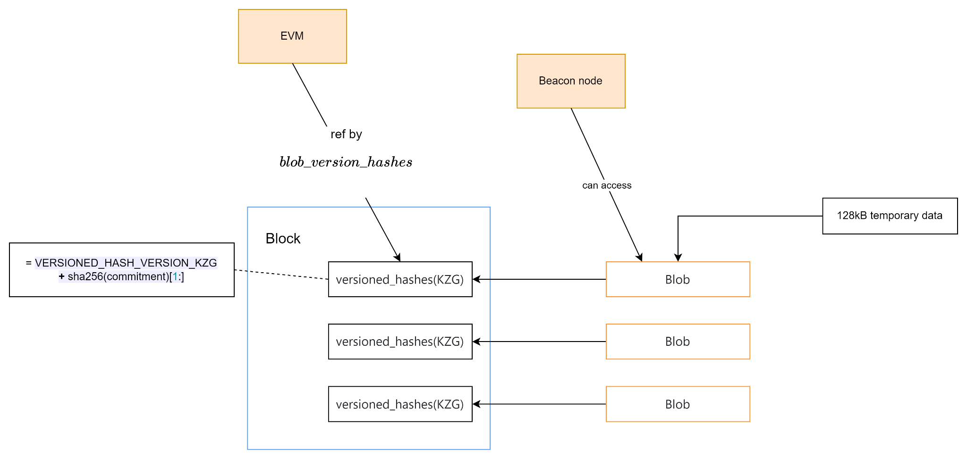
Proto-Danksharding

Slide 15
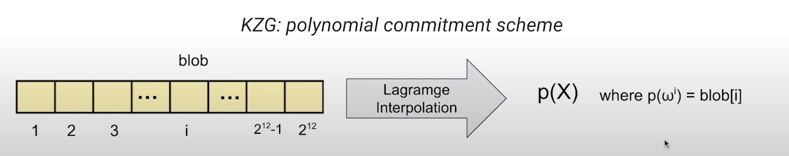
Proto-Danksharding
Anatomy of a Blob:
4096 chunks of 32 bytes each
Compute P(x) s.t. P(⍵^{i}) = blob[i] (⍵⁴⁰⁹⁶ = 1)
Pick secret number s, compute P(s) as commitment

Slide 16
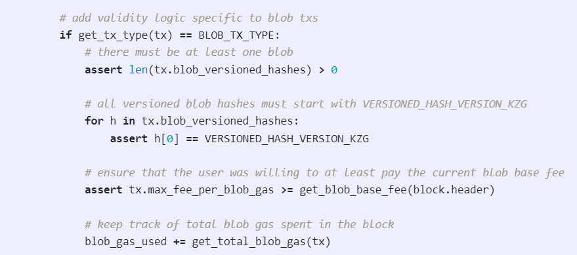
Proto-Danksharding
Contract changes:
Update L1 proof to use blob
Change verifier code to retrieve blob data
Change batch-submitter code to encode and submit with new blob data
Pseudocode for general case

Slide 17
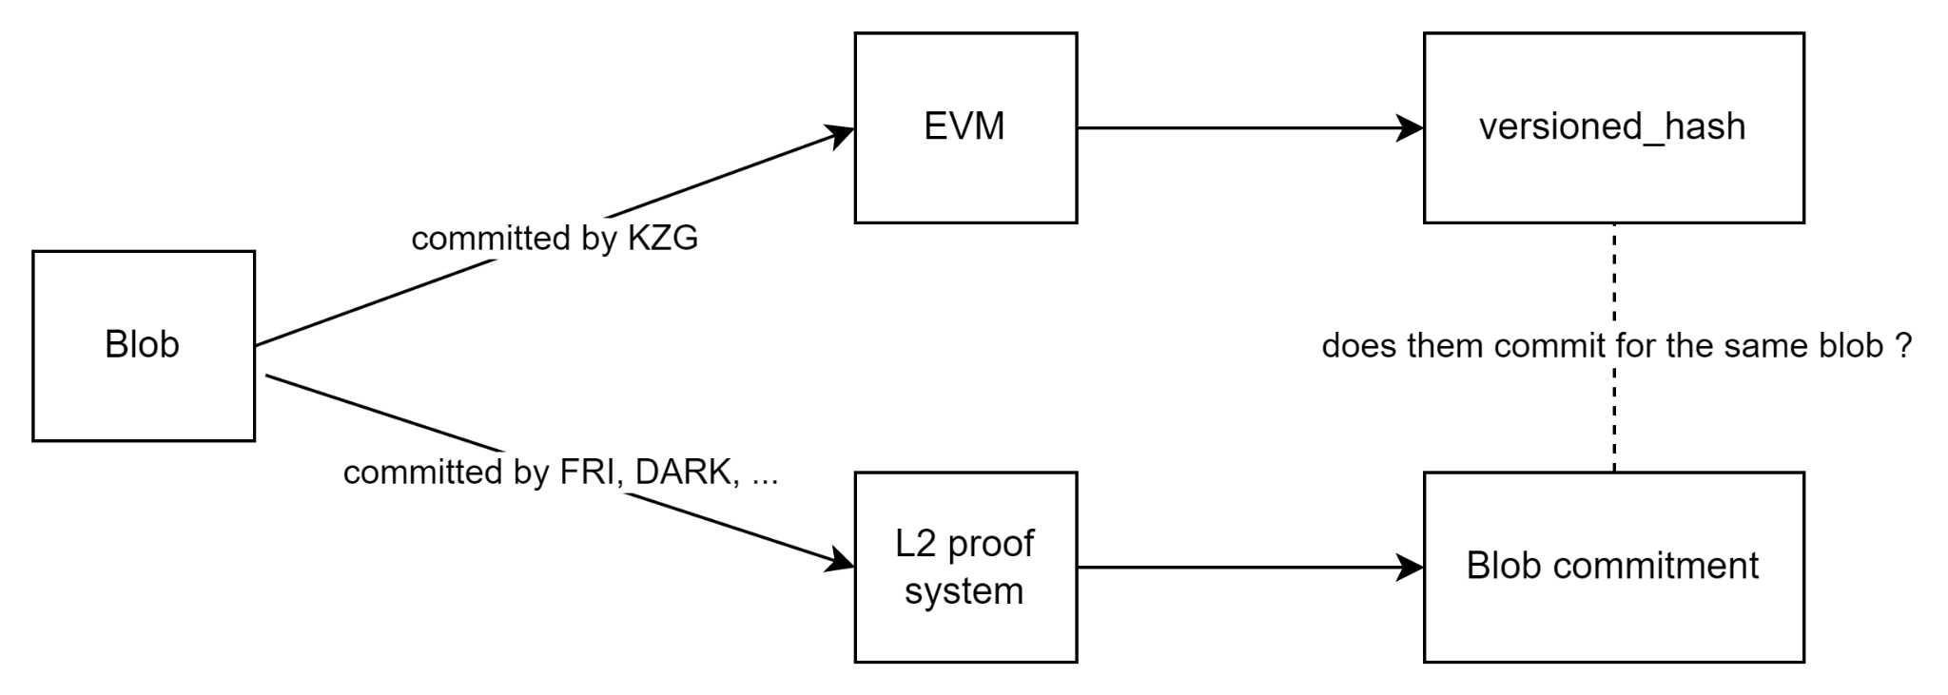
Proto-Danksharding
Compatible with Zk-Rollup:
Proof the correct data was imported
Using point evaluation precompile

Slide 18
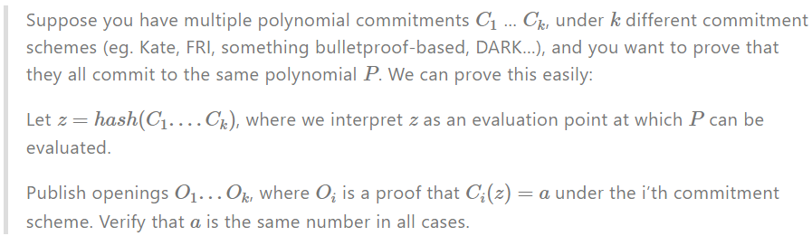
Proto-Danksharding
Compatible with Zk-Rollup:
Proof the correct data was imported
Using point evaluation precompile
To check if some polynomial commitment schemes commit to the same polynomial P
Work with BLS12-381 modulus

Slide 19
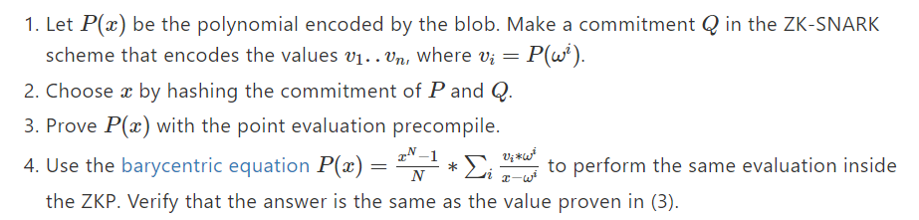
Proto-Danksharding
Compatible with Zk-Rollup:
Proof the correct data was imported
Using point evaluation precompile
To check if some polynomial commitment schemes commit to the same polynomial P
Works with any ZK-SNARK

Slide 20
Proto-Danksharding
Compatible with Zk-Rollup:
Proof the correct data was imported
Proof the ZK transition

Slide 21
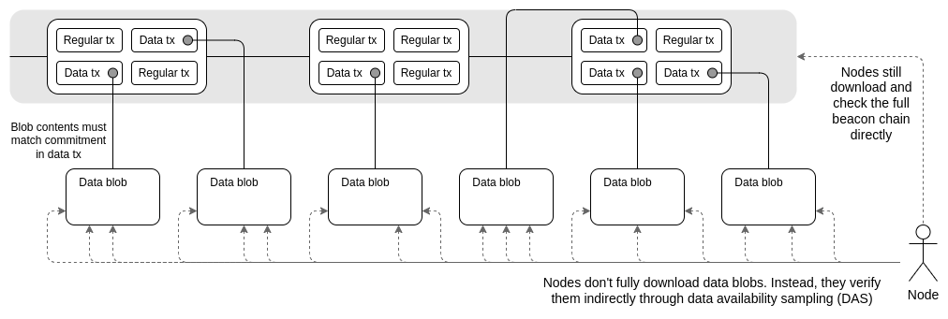
Danksharding
Large amounts of blob data - validating nodes small

Slide 22
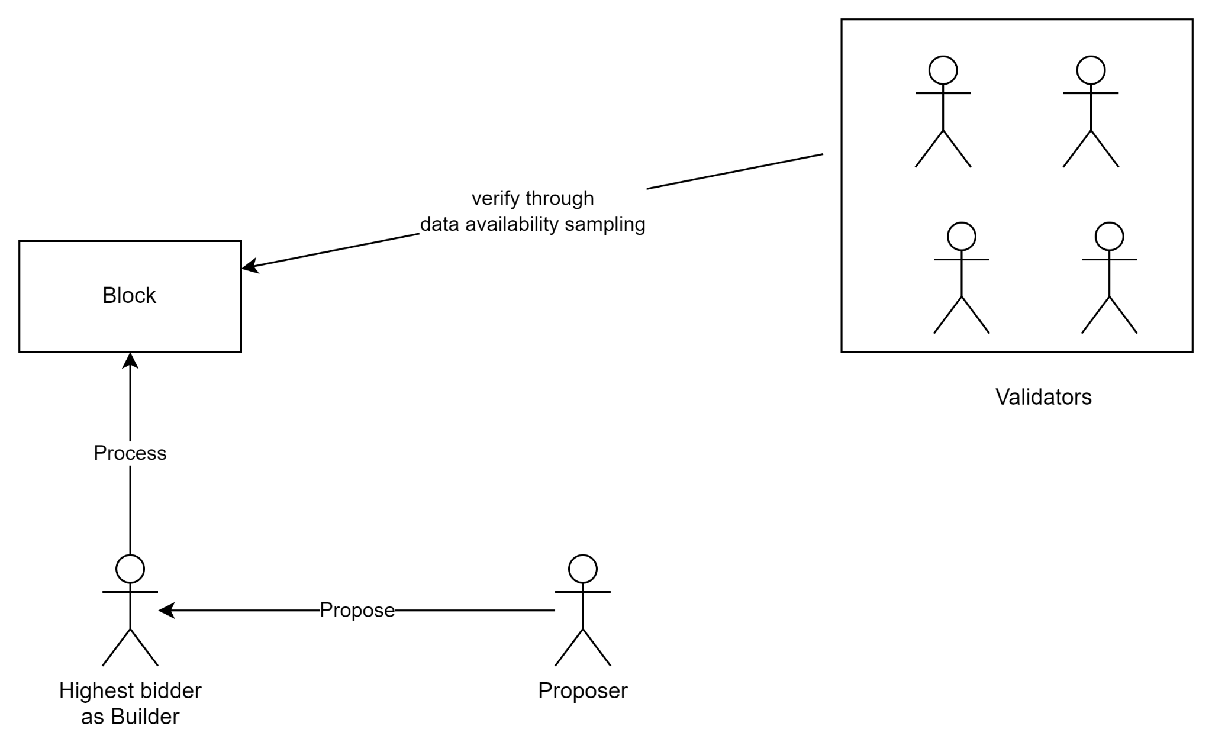
Danksharding
Proposer/builder separation (PBS):
Block builder processes the entire block
Proposer selects the valid header with the highest bid
Validators verify the block data via data availability sampling

Slide 23
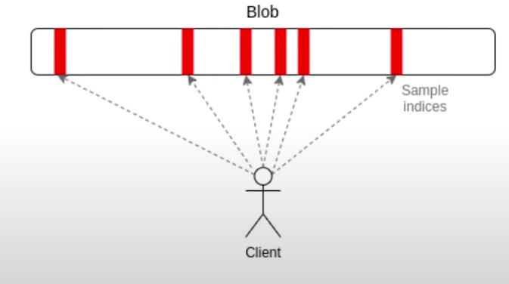
Danksharding
Data availability sampling:

Slide 24
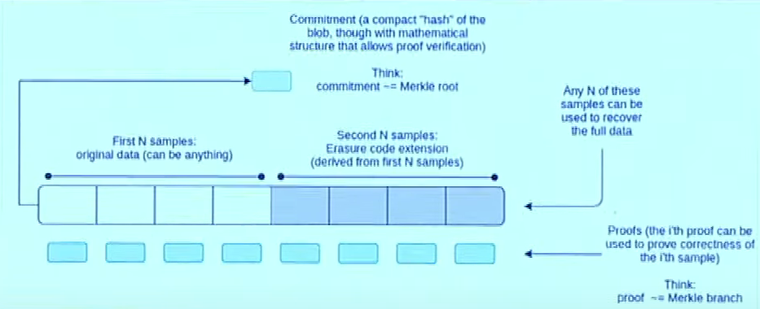
Danksharding
Erasure Coding:

Slide 25
Danksharding
Work remains to achieve Danksharding:
A low-degree extension of the commitments in the consensus layer to allow 2D sampling
An actual implementation of data availability sampling
PBS (proposer/builder separation)
Proof of custody or similar in-protocol requirement for each validator to verify a particular part of the sharded data in each block

Slide 26
References:
https://eips.ethereum.org/EIPS/eip-4844
https://www.eip4844.com/#help-out
https://domothy.com/blobspace/
https://www.youtube.com/watch?v=QX8qFzuGaEE
https://www.youtube.com/watch?v=5Fp70DF1uaY&t=20s

